Slide 1

w
w
w
CODE OF CONDUCT
1
Listen to all staff and follow their instructions and school rules.
2
Hand in any personal devices or electronic equipment at the beginning of the day.
3
Go to lessons promptly.
Be ready to learn and try your best in every lesson.
4
5
Stay in your own classroom unless given permission to leave.
6
Do not touch or use equipment unless asked to do so.
7
Respect your environment and all school equipment property.
8
Be respectful and kind yourself and others.
9
Do not interrupt others and wait your turn.
10
Come to school in appropriately clothes and footwear.

Slide 2
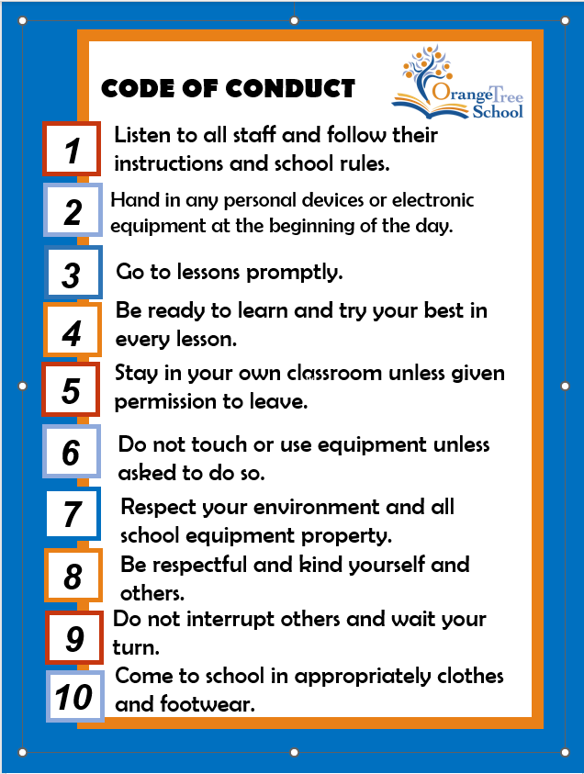
I, _ _ _ _ _ _ _ _ _ _ _ _ _ _ _ _ understand and agree to follow the School Code of Conduct.
Signed _ _ _ _ _ _ _ _ _ _ _ _ _ _ Date _ _ _ _ _ _ _ _ _ _ _ _ _

Slide 3

As a result of my behaviour, I agree to follow code number/s _ _ _ _ _ _ _ _ _ _ _
Signed _ _ _ _ _ _ _ _ _ _ _ _ _ _ Date _ _ _ _ _ _ _ _ _ _ _ _ _

